Slide 1
INTELLIGENT DECISON SUPPORT
(FUZZY LOGIC)
(#6)
Prof. Dr. Ercan Oztemel

Slide 2
CONTENTS…
Fuzzy Logic- Introduction
Probability and uncertainty
Crisp and fuzzy sets
Applications

Slide 3
Fuzzy Logic – A Definition
Fuzzy logic provides a method to formalize reasoning when dealing with vague terms. Traditional computing requires finite precision which is not always possible in real world scenarios. Not every decision is either true or false, or as with Boolean logic either 0 or 1. Fuzzy logic allows for membership functions, or degrees of truthfulness and falsehoods. Or as with Boolean logic, not only 0 and 1 but all the numbers that fall in between.
“Fuzzy logic is derived from fuzzy set theory dealing with reasoning which is approximate rather than precisely deduced from classical predicate logic”

Slide 4
History, State of the Art, and Future Development
1965 Seminal Paper “Fuzzy Logic” by Prof. Lotfi Zadeh, Faculty in Electrical Engineering, U.C. Berkeley, Sets the Foundation of the “Fuzzy Set Theory”
1970 First Application of Fuzzy Logic in Control Engineering (Europe)
1975 Introduction of Fuzzy Logic in Japan
1980 Empirical Verification of Fuzzy Logic in Europe
1985 Broad Application of Fuzzy Logic in Japan
1990 Broad Application of Fuzzy Logic in Europe
1995 Broad Application of Fuzzy Logic in the U.S.
2000 Fuzzy Logic Becomes a Standard Technology and Is Also Applied in Data and Sensor Signal Analysis. Application of Fuzzy Logic in Business and Finance.
Today, Fuzzy Logic Has Already Become the Standard Technique for Problem Solving !

Slide 5
Types of Uncertainty and the Modeling of Uncertainty
Stochastic Uncertainty:
The Probability of Hitting the Target Is 0.8
Lexical Uncertainty:
"Tall Men", "Hot Days", or "Stable Currencies"
We Will Probably Have a Successful Business Year.
The Experience of Expert A Shows That B Is Likely to Occur. However, Expert C Is Convinced This Is Not True.
Most Words and Evaluations We Use in Our Daily Reasoning Are Not Clearly Defined in a Mathematical Manner. This Allows Humans to Reason on an Abstract Level!

Slide 6
Probability and Uncertainty
“... a person suffering from hepatitis shows in 60% of all cases a strong fever, in 45% of all cases yellowish colored skin, and in 30% of all cases suffers from nausea ...”
Stochastics and Fuzzy Logic Complement Each Other !

Slide 7
Fuzzy Set Theory
Conventional (Boolean) Set Theory:
38.7°C
38°C
40.1°C
41.4°C
42°C
Fuzzy Set Theory:
39.3°C
“Strong Fever”
38.7°C
37.2°C
38°C
40.1°C
41.4°C
“More-or-Less” Rather Than “Either-Or” !
42°C
39.3°C
“Strong Fever”
37.2°C

Slide 8
Fuzzy and Crisp Set Theories
In traditional set theory, an element either belongs to a set, or it does not.
Membership functions of fuzzy logic classify elements in the range [0,1], with 0 and 1 being no and full inclusion, the other values being partial membership

Slide 9
Crisp vs. Fuzzy Sets
The classical example in fuzzy sets is tall men. The elements of the fuzzy set “tall men” are all men, but their degrees of membership depend on their height.
The x-axis represents the universe of discourse – the range of all possible values applicable to a chosen variable. In our case, the variable is the man height. According to this representation, the universe of men’s heights consists of all tall men.
The y-axis represents the membership value of the fuzzy set. In our case, the fuzzy set of “tall men” maps height values into corresponding membership values.

Slide 10
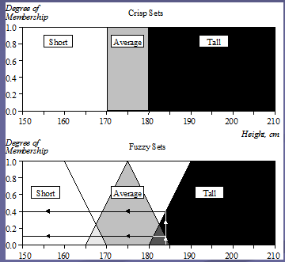
Fuzzy Set Representation
First, we determine the membership functions. In our “tall men” example, we can obtain fuzzy sets of tall, short and average men.
The universe of discourse – the men’s heights – consists of three sets: short, average and tall men. As you will see, a man who is 184 cm tall is a member of the average men set with a degree of membership of 0.1, and at the same time, he is also a member of the tall men set with a degree of 0.4.

Slide 11
Linguistic Variables
At the root of fuzzy set theory lies the idea of linguistic variables.
A linguistic variable is a fuzzy variable. For example, the statement “John is tall” implies that the linguistic variable John takes the linguistic value tall.
In fuzzy expert systems, linguistic variables are used in fuzzy rules. For example:
IF wind is strong
THEN sailing is good
IF project_duration is long
THEN completion_risk is high
IF speed is slow
THEN stopping_distance is short

Slide 12
Linguistic Variables and Hedges
The range of possible values of a linguistic variable represents the universe of discourse of that variable. For example, the universe of discourse of the linguistic variable speed might have the range between 0 and 220 km/h and may include such fuzzy subsets as very slow, slow, medium, fast, and very fast.
A linguistic variable carries with it the concept of fuzzy set qualifiers, called hedges.
Hedges are terms that modify the shape of fuzzy sets. They include adverbs such as very, somewhat, quite, more or less and slightly.

Slide 13
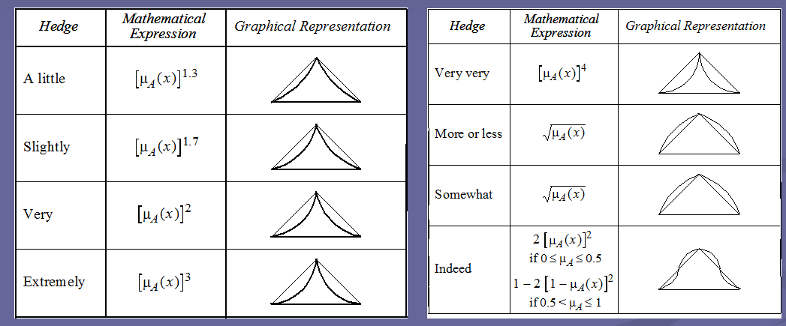
Linguistic Variables and Hedges

Slide 14
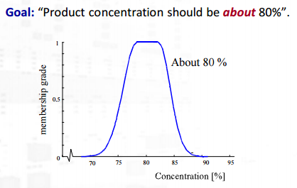
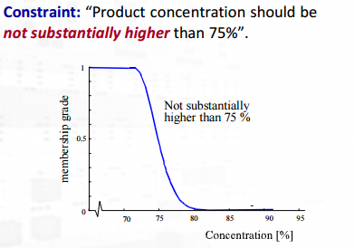

Slide 15
Conceptualizing in fuzzy terms...
One representation for the fuzzy number "about 600".

Slide 16
Conceptualizing in fuzzy terms...
Representing truthfulness (certainty) of events as fuzzy sets over the [0,1] domain.

Slide 17
Conceptualizing in fuzzy terms...
Membership functions representing three fuzzy sets for the variable "height".

Slide 18
Conceptualizing in fuzzy terms...
Example of Linguistic Variable “Error”:
1
large_p: 10 positive: 3
zero: 0
negative: -3
large_n: -10
µ
0
-10
-5
0
+5
+10
Error

Slide 19
Defining a fuzzy membership functions
Discrete Definition:
µ_{SF}(35°C) = 0 µ_{SF}(38°C) = 0.1 µ_{SF}(41°C) = 0.9
µ_{SF}(36°C) = 0 µ_{SF}(39°C) = 0.35 µ_{SF}(42°C) = 1
µ_{SF}(37°C) = 0 µ_{SF}(40°C) = 0.65 µ_{SF}(43°C) = 1
Continuous Definition:
No More Artificial Thresholds!

Slide 20
Defining a fuzzy membership functions
...Terms, Degree of Membership, Membership Function, Base Variable...
… pretty much raised …
A Linguistic Variable Defines a Concept of Our Everyday Language!
... but just slightly strong …

Slide 21
Formal Definitions
Definition 1: Let X be some set of objects, with elements noted as x.
X = {x}.
Definition 2: A fuzzy set A in X is characterized by a membership function µA(x) which maps each point in X onto the real interval [0.0, 1.0]. As µA(x) approaches 1.0, the "grade of membership" of x in A increases.
Definition 3: A is EMPTY iff for all x, µA(x) = 0.0.
Definition 4: A = B iff for all x: µA(x) = µB(x) [or, µA = µB].
Definition 5: µA' = 1 - µA.
Definition 6: A is CONTAINED in B iff µA ≤ µB.
Definition 7: C = A UNION B, where: µC(x) = MAX(µA(x), µB(x)).
Definition 8: C = A INTERSECTION B where: µC(x) = MIN(µA(x), µ B(x)).

Slide 22
Definition of the Fuzzy Rules - Aggregation Operator -
Elementary Fuzzy Logic Operators:
AND: µ_{AvB} = min{ µ_{A}; µ_{B} }
OR: µ_{A+B} = max{ µ_{A}; µ_{B} }
NOT: µ_{-A} = 1 - µ_{A}
...Model Human Evaluation and Reasoning Poorly Sometimes
Example: IF Car=fast AND Car=economical THEN Car=good
Car 1: 180^{km}/_{h}: µ=0.3 9^{l}/_{100km}: µ=0.4 -> 0.3
Car 2: 180^{km}/_{h}: µ=0.3 7^{l}/_{100km}: µ=0.6 -> 0.3
Car 3: 175^{km}/_{h}: µ=0.25 4^{l}/_{100km}: µ=0.9 -> 0.25
Mock-Up Solution: Define More Fuzzy Rules:
The Exclusive Use of Elementary Fuzzy Logic Operators Can Inflate the Rule Base !
Pretty fast
highly_economic
pretty good
IF Car=fast AND Car=economical THEN Car=good
somewhat_fast
mildly_economic
just_ok

Slide 23
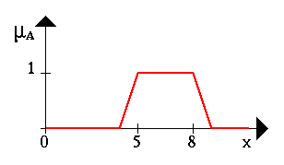
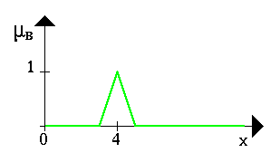
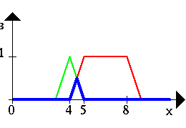
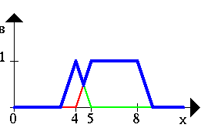
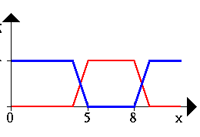
Operations with fuzzy sets
A B
A ∧ B A ∨ B ¬A

Slide 24
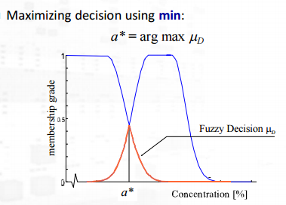

Slide 25
Operations with fuzzy sets
Five operations with two fuzzy sets A and B approximately represented in a graphical form

Slide 26
Rule Base
Air Temperature
Set cold {50, 0, 0}
Set cool {65, 55, 45}
Set just right {70, 65, 60}
Set warm {85, 75, 65}
Set hot {∞, 90, 80}
Fan Speed
Set stop {0, 0, 0}
Set slow {50, 30, 10}
Set medium {60, 50, 40}
Set fast {90, 70, 50}
Set blast {∞, 100, 80}

Slide 27
Rules
Air Conditioning Controller Example:
IF Cold then Stop
If Cool then Slow
If OK then Medium
If Warm then Fast
IF Hot then Blast

Slide 28
Fuzzy Air Conditioner

Slide 29
Mapping Inputs to Outputs

Slide 30
Basic Elements of a Fuzzy Logic System
Fuzzy Logic Defines the Control Strategy on a Linguistic Level!
Fuzzification, Fuzzy Inference, Defuzzification:

Slide 31
Basic Elements of a Fuzzy Logic System
An Example
Container Crane Case Study:
Two Measured Variables and One Command Variable !

Slide 32
Basic Elements of a Fuzzy Logic System: An Example
Control Loop of the Fuzzy Logic Controlled Container Crane:
Closing the Loop With Words !

Slide 33
Fuzzification: - Linguistic Variables
Term Definitions:
Distance:= {far, medium, close, zero, neg_close}
Angle:= {pos_big, pos_small, zero, neg_small, neg_big}
Power:= {pos_high, pos_medium, zero, neg_medium, neg_high}
The Linguistic Variables Are the “Vocabulary” of a Fuzzy Logic System!
Membership Function Definition:
0.9
0.8
0.2
0.1
4°
12m

Slide 34
Fuzzy-Inference: - “IF-THEN”-Rules -
Computation of the “IF-THEN”-Rules:
#1: IF Distance = medium AND Angle = pos_small THEN Power = pos_medium
#2: IF Distance = medium AND Angle = zero THEN Power = zero
#3: IF Distance = far AND Angle = zero THEN Power = pos_medium
Aggregation: Computing the “IF”-Part
Composition: Computing the “THEN”-Part
The Rules of the Fuzzy Logic Systems Are the “Laws” It Executes !

Slide 35
Fuzzy-Inference: - Aggregation -
Boolean Logic Only Defines Operators for 0/1:
A B AvB
0 0 0
0 1 0
1 0 0
1 1 1
Fuzzy Logic Delivers a Continuous Extension:
AND: µ_{AvB} = min{ µ_{A}; µ_{B} }
OR: µ_{A+B} = max{ µ_{A}; µ_{B} }
NOT: µ_{-A} = 1 - µ_{A}
Aggregation of the “IF”-Part:
#1: min{ 0.9, 0.8 } = 0.8
#2: min{ 0.9, 0.2 } = 0.2
#3: min{ 0.1, 0.2 } = 0.1
Aggregation Computes How “Appropriate” Each Rule Is for the Current Situation !

Slide 36
Fuzzy-Inference: Composition
Result for the Linguistic Variable "Power":
pos_high with the degree 0.0
pos_medium with the degree 0.8 ( = max{ 0.8, 0.1 } )
zero with the degree 0.2
neg_medium with the degree 0.0
neg_high with the degree 0.0
Composition Computes How Each Rule Influences the Output Variables !

Slide 37
Defuzzification
Finding a Compromise Using “Center-of-Maximum”:
“Balancing” Out the Result !
6.4 KW

Slide 38
Problem Definition
A company is producing a new product and wants to define the price for that.
The cost of the product is 12 units.
The product is sold in the market for 22 units.
The General Manager set up a meeting with Production Manager, Marketing Manager, Finance Manager and Customer Relations Manager.
The question posed to them: What will be the price for the new product.

Slide 39
Yönetici Görüşleri
Marketing: Price should be LOW
Finance: Price should be AROUND 2 TIMES of COST
Production: Price should be HIGH
Customer Relations: The prices should be CLOSE TO COMPETITORS’?
If you were the General Manager, What would be your decision on the price.

Slide 40
Membership Function
1
HIGH
0
15
36
Price

Slide 41
Membership Function
1
1
1
LOW
0
0
0
15
36
Price

Slide 42
Membership Function
1
AROUND 2*COST
0
24
Price

Slide 43
Membership Function
1
CLOSE TO
COMPETITORS’
0
22
Fiyat

Slide 44
Defining the price-1: The price is LOW
1
0
15
36

Slide 45

Defining the price-2 : The price is LOW & HIGH
1
0.5
0
15
36

Slide 46
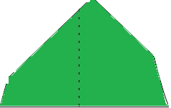
Defining the price-3: The price is LOW & HIGH & AROUND 2*COST
1
0.5
0
15
24
36

Slide 47
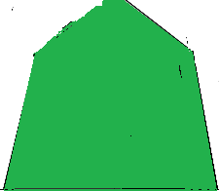
Defining the price-4
The price is LOW & HIGH & AROUND 2*COST CLOSE TO COMPETITORS’
1
0.5
0
15
36

Slide 48
Defining the price-5
0.5
0
Fiyat
22.75

Slide 49
QUESTIONS
?
THANK YOU VERY MUCH

